Slide 1


Troubleshooting Guide – Contamination Error HS-50F
--- Marcos Magalhaes
MIS Customer Service Department – Mindray LATAM

Slide 2
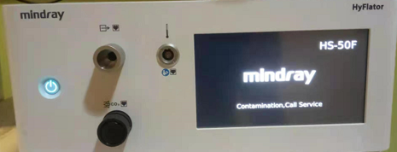
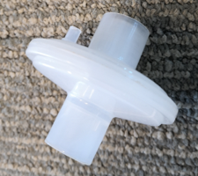
Background
Fault description: The customer reported that an error occurred during use, and the error message “contamination” is displayed on touch screen.
Analysis of the cause of the failure: The insufflator was contaminated by liquid backflow.
Solution: Recommendation for item replacement, software update and flow calibration :
.
Prevention: The insufflator should be placed higher than patient and use filter for every surgery.
PN | Description | Qtd
115-063725-00 | Sensor hose FRU | 1
115-076020-00 | Influent contamination FRU | 1
115-077921-00 | Gas cycle FRU | 1

Slide 3
Disassembly

Slide 4
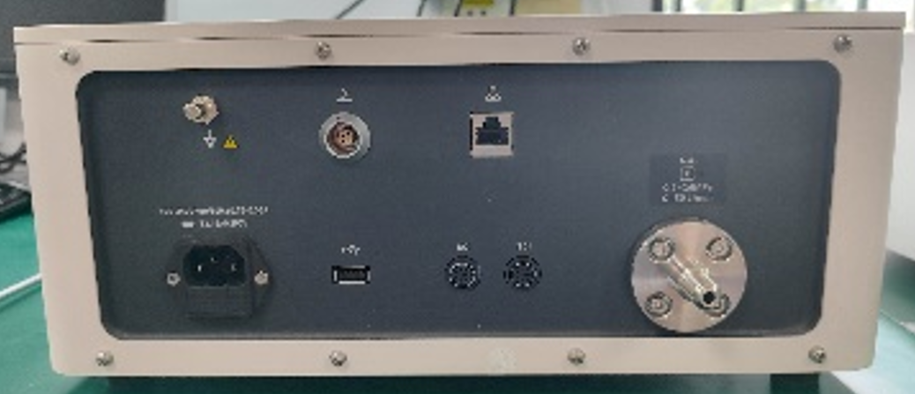
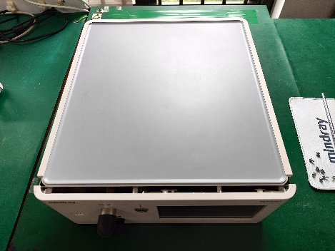
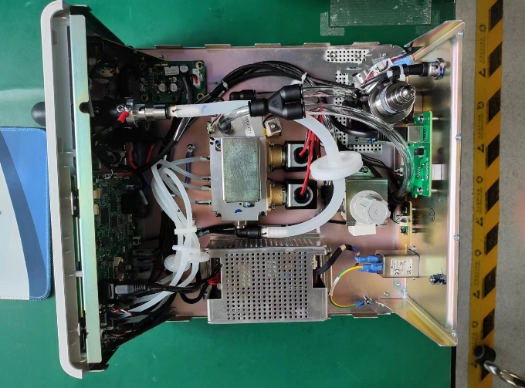
1. Remove Top Cover
Tools & Materials | Phillips screwdriver | Figures
Steps | Remove eight M3 combination screws on the rear panel with Phillips screwdriver; Pull the top cover backwards and remove the top cover.
M3 combination screws

Slide 5
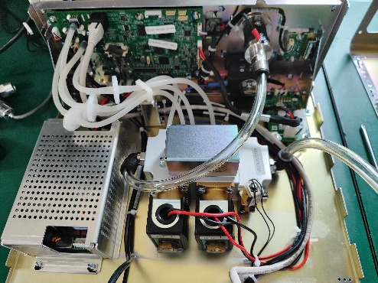
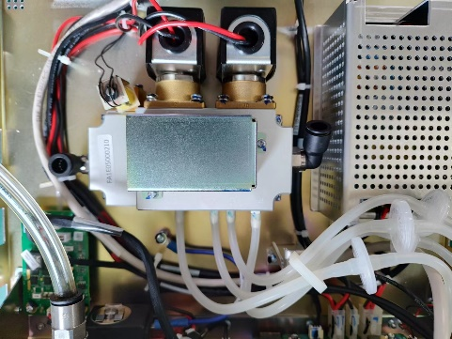
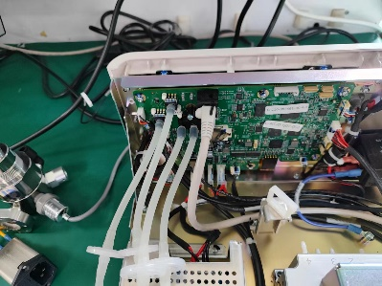
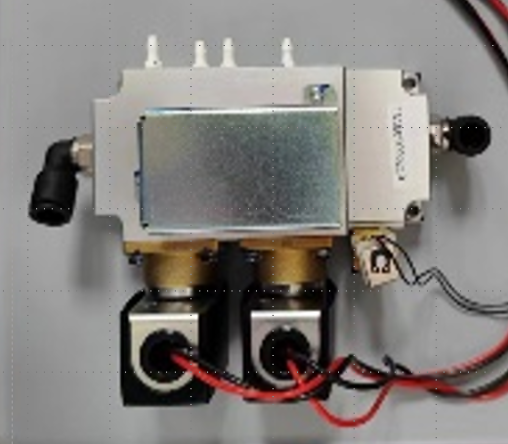
2. Disassembling the Pneumatic Module
Tools & Materials | Phillips screwdriver | Figures
Steps | Remove top cover according to previous steps; Remove all the cables and tubes connected to the pneumatic module; Use a Phillips screwdriver to remove the four M4×12 combination screws that fix the pneumatic module; Then, the pneumatic module can be removed. Note: Pls follow the figures for the connecting of the tubes between main board and pneumatic module. ① ②: flow rate sensor (Differential pressure sensor) ③: Pressure sensor: check internal pressure in Pneumatic module ④: Pressure sensor: check the abdominal cavity pressure
sensor connection tubes
Tube
M4×12 combination screw
Pneumatic module
4
3
2
1
4
2
1
3

Slide 6
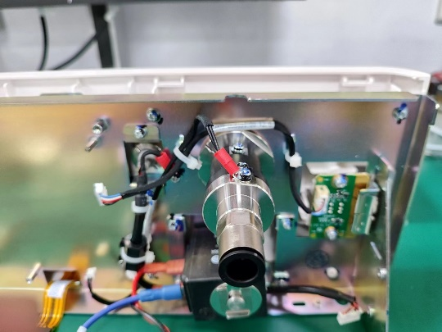
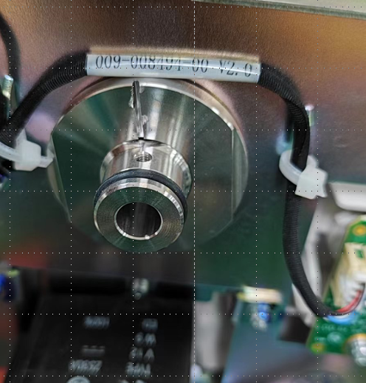
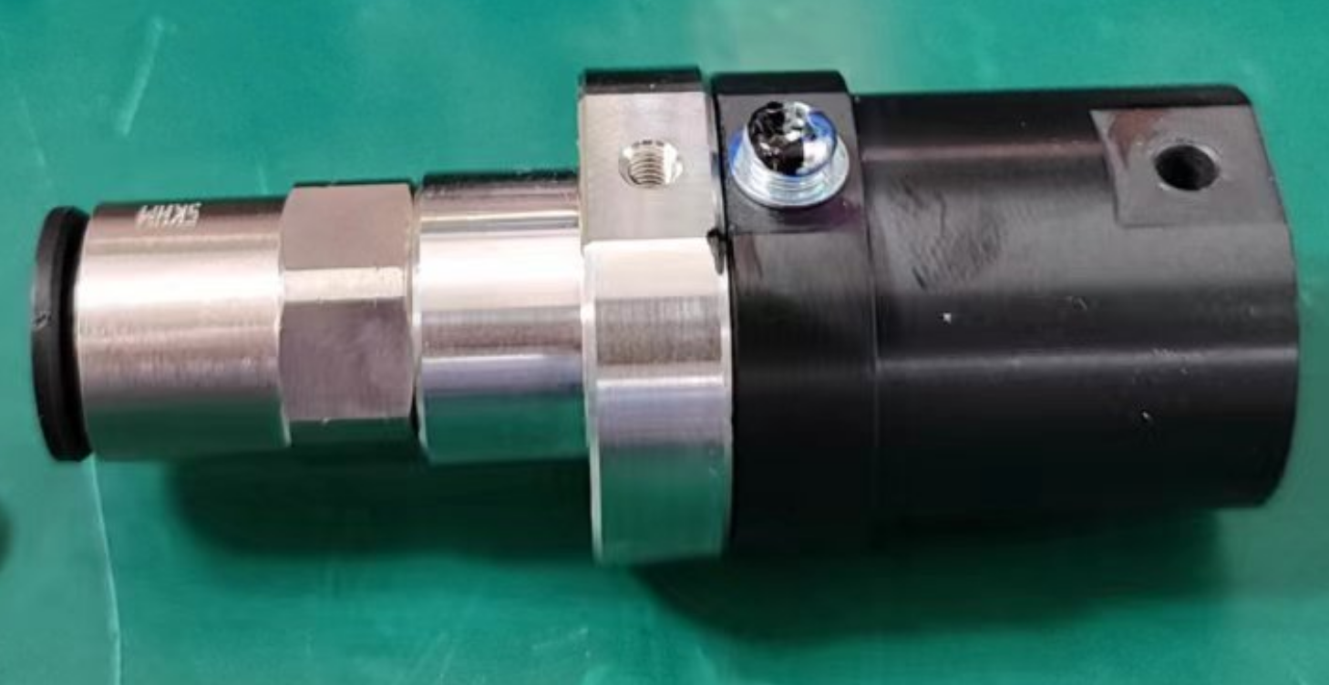
3. Disassembling the Liquid Sensor and Outlet Connector
Tools & Materials | Phillips screwdriver | Figures
Steps | Remove top cover according to previous steps. First use a Phillips screwdriver to remove one M3×8 combination screw of the liquid sensor cable, and then remove the liquid sensor cable. Use a Phillips screwdriver to remove one M3×8 combination screw; Remove the liquid sensor;
M3×8 combination screw
liquid sensor

Slide 7
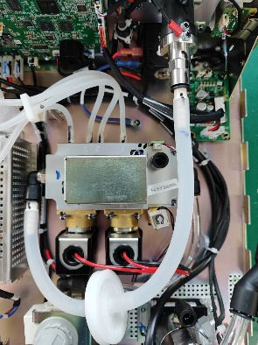
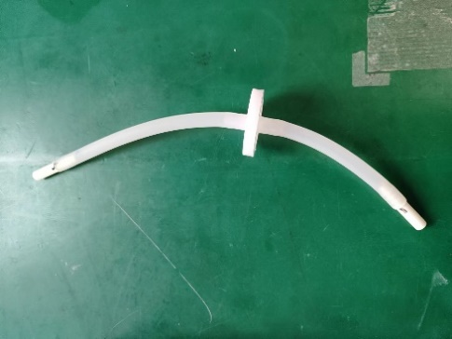
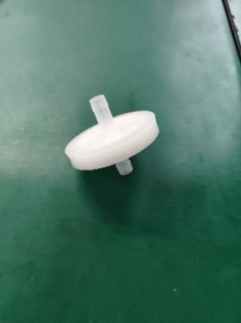
4. Disassembling the Anti-Contamination Filter
Tools & Materials | Phillips screwdriver | Figures
Steps | Remove top cover according to previous steps Press the end of the quick-in connector inward to pull the pagoda connectors out of the quick-in connector and remove the pipe; Remove the anti-contamination filter assembly as shown in.
Anti-Contamination Filter

Slide 8
Software Upgrade

Slide 9
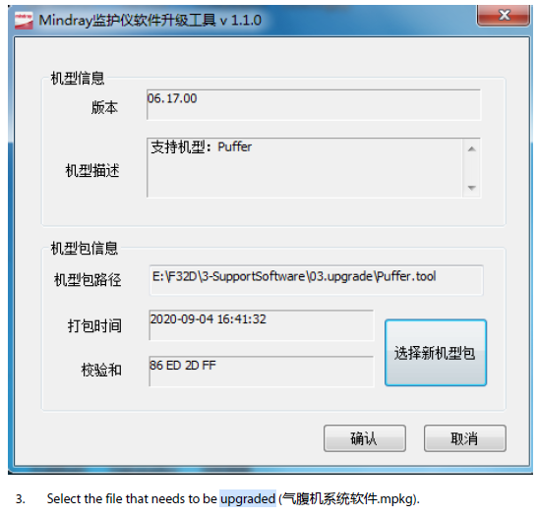
Software Upgrading Procedure – v1.0
The network upgrade can be realized using the Mindray monitor network upgrade tool.
1. First set the PC IP address to 77.77.1.1xx. Connect the device and the PC directly with a network cable.
2. Open the Mindray monitor software upgrade tool, select the model package Puffer.tool.

Slide 10
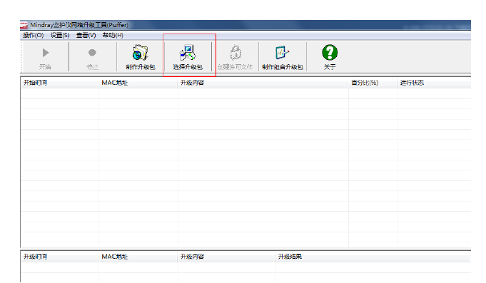
Software Upgrading Procedure – v1.0
Click Start, and then turn on the insufflator. The device automatically starts upgrading

Slide 11
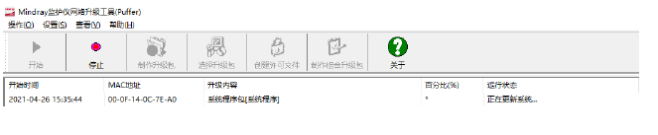
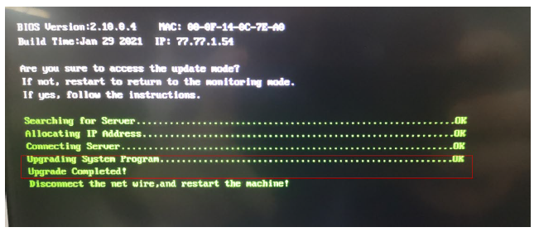
Software Upgrading Procedure – v1.0
After the upgrade is complete, turn off the insufflator, unplug the network cable to complete the upgrade. The prompt of upgrade completion may be different

Slide 12
USB Flash Drive Upgrade

Slide 13
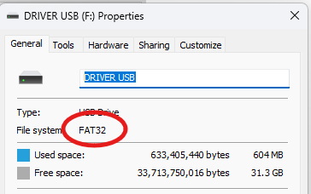
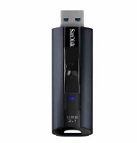


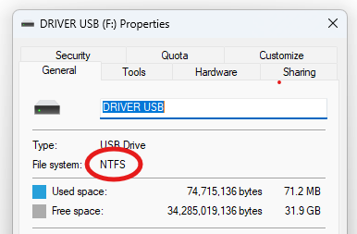

Preparation for Error Log Extraction - HS-50F
Use a FAT32 formatted USB stick to ensure compatibility. NTFS and exFAT are not supported. Prefer common models to avoid problems with recognition by the device.
FAT32 compatibility only
Mindray USB recommendation
Brand | Type | Capacity
Kingston | DTSE9G2 | 128G
SanDisk | CZ880 | 128G
Toshiba | A3 | 2T
WD Elements | WDBU6Y0 040BBK | 4T
Incompatible with NTFS/ExFat format

Slide 14
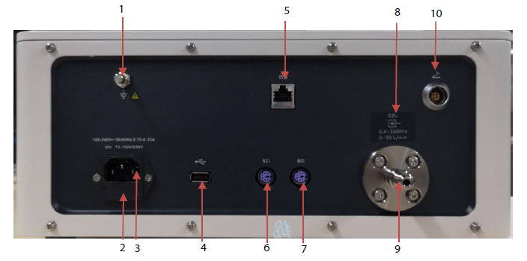
Software Upgrading Procedure – v2.0
1. After formatting the USB drive correctly, plug the USB into the rear port of the HS-50F inflator
2. Only insufflator V2.0 can be upgraded through a USB flash drive. The upgrade procedure is shown as follows:
Get the USB flash drive: The general version system of the insufflator can be upgraded with a FAT32 format flash drive. Create a new /UPGRADE_AMP/Puffer directory
in the USB flash drive, and copy “Puffer_Installer.pkg” and the insufflator system software in the archived upgrade tool to the directory
3. Insert the USB flash drive into the USB port on the rear panel of the insufflator system before booting. The insufflator will automatically enter the upgrade interface after booting. See the following figure.
4 – Porta USB

Slide 15
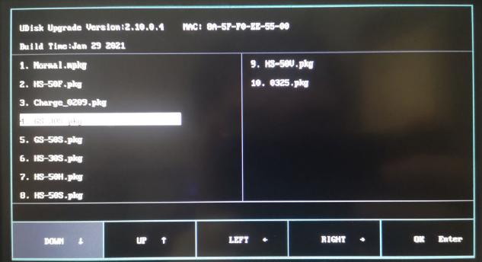
Preparation for Error Log Extraction - HS-50F
3. Insert the USB flash drive into the USB port on the rear panel of the insufflator system before booting. The insufflator will automatically enter the upgrade interface after booting. See the following figure.

Slide 16
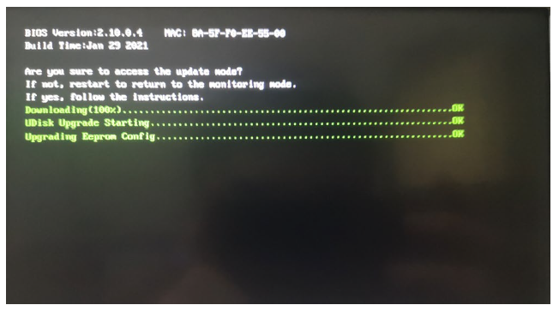
Preparation for Error Log Extraction - HS-50F
4. Select Puffer_Installer.mpkg. Tap OK to start the upgrade

Slide 17
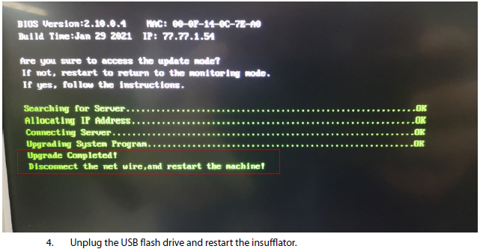
Preparation for Error Log Extraction - HS-50F
5. After the upgrade is complete, the interface will display the following information:

Slide 18
Flow calibration After Software Upgrade

Slide 19
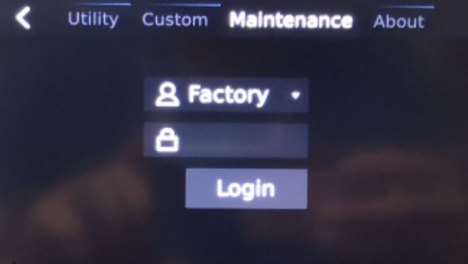
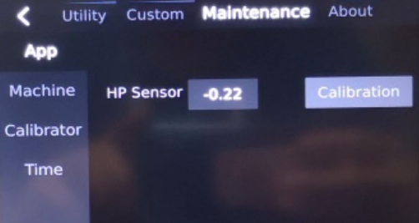
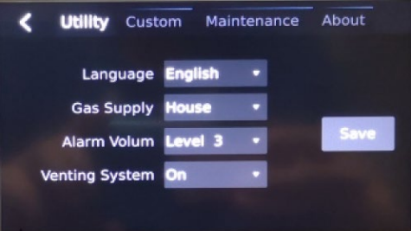
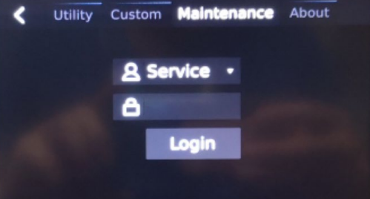
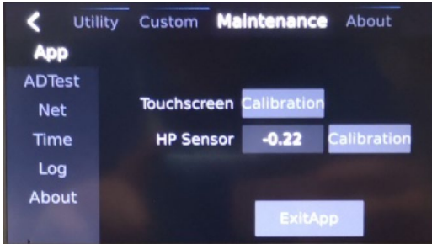
How to Enter Maintenance Interface
Insufflator V1.0
Enter Factory Maintenance Mode:
1. In the standby mode, tap Setting, and select the Maintenance menu.
2. Select Factory in the selection box, enter the login password 7782, and tap Login to enter the production maintenance interface.
Tap Setting on the home page to enter the setting interface
Enter Service Maintenance Mode:
1. In the standby mode, tap Setting, and select the Maintenance menu.
2. Select Service in the selection box, enter the login password 8277, and tap Login to enter the user service maintenance interface.

Slide 20
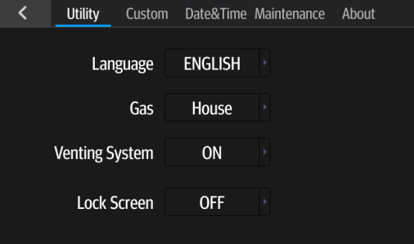
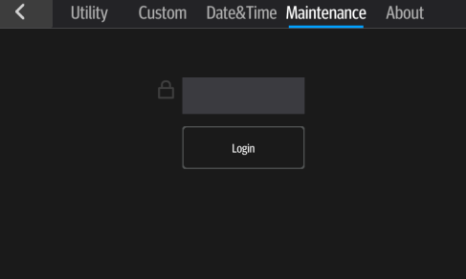
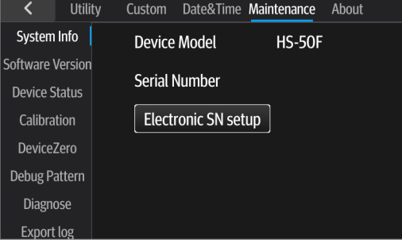
How to Enter Maintenance Interface
Insufflator V2.0
Step 1
Tap Setting on the home page to enter the setting interface
Step 2
After entering the login password "332888", you can log in to the Maintenance Interface.
Step 3
Enter Maintenance Mode

Slide 21
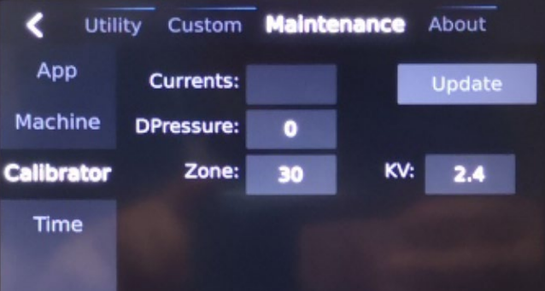
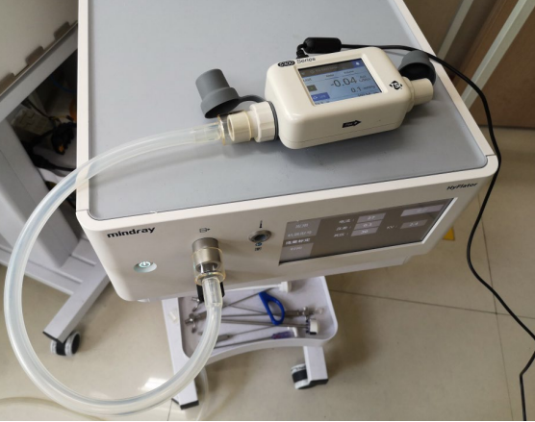
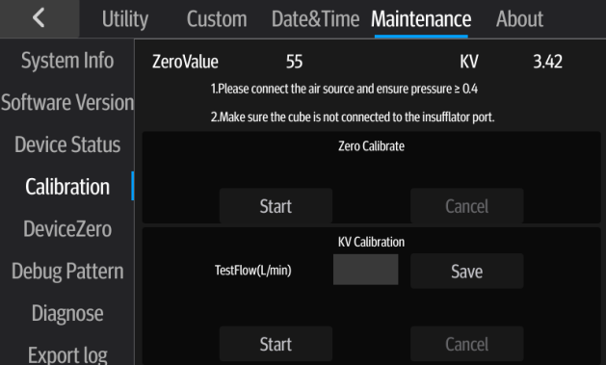
Flow Calibration-KV Calibration
KV value: refers to the flow rate/pressure difference ratio of the differential pressure meter in the flow sensor (used as a filter for generating the pressure difference). After this KV value is obtained, the flow rate can be calculated by the formula: Flow rate = KV * differential pressure. Since the KV value of the differential pressure meter (filter) used by the insufflator has better linearity, you only need to test the pressure difference and the actual flow rate at one point, and use the formula KV=actual flow/pressure difference to obtain the KV value
Preparation:
Connect the gas source and ensure that the gas source pressure is ≥ 0.4 MPa.
Connect the gas outlet of the insufflator and the flowmeter (the unit of the flowmeter is set to ACT L/min, and the gas type is CO2. )
Insufflator V1.0
Route: Factory maintenance>Calibrator
Input the initial value of current as 93, and tap the Update button.
Observe the flow of the flowmeter, calculate the KV value (KV=flow/pressure difference), and input the obtained KV value.
Exit the factory maintenance page to complete the KV value calibration.
Insufflator V2.0
Route: Maintenance>Calibration;
Tap Start of KV calibration. The insufflator will start the flow calibration. After the measured value of the flowmeter is stable, input the measured flow value (in L/min) in the test flow edit box, and then tap Save to complete the KV value calibration

Slide 22
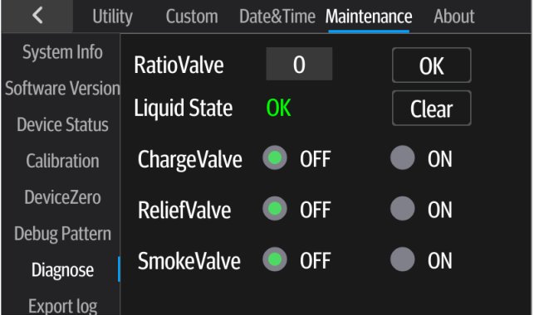
Liquid Inlet State Clear
Liquid inlet state clear: It means to clear the state of water ingress. When liquid enters the insufflator, error message “Contamination” will be displayed. After replacing the liquid sensor, it requires to clear this error state.
Insufflator V1.0
Replace liquid inlet sensor repair spare parts (international: 115-063729-00)
Upgrade the software
Insufflator V2.0
Replace liquid inlet contamination repair spare parts (115-076020-00);
Enter the diagnosis function interface, tap the Clear button, and change the liquid status to OK to complete the contamination removal.
liquid sensor

Slide 23
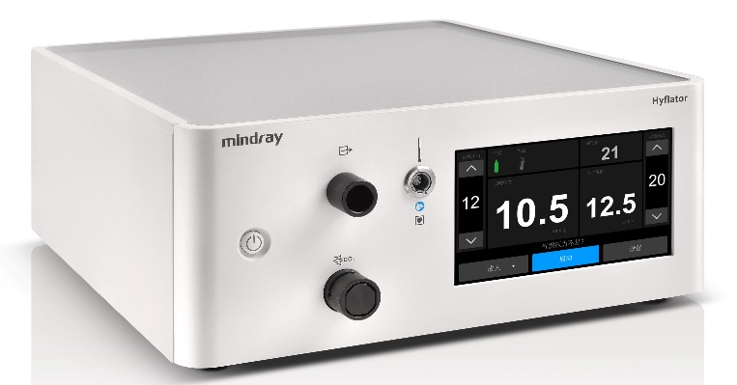
C
01
Disassembly
ONTENTS
Test After Repair
02
Calibration
03
Test

Slide 24
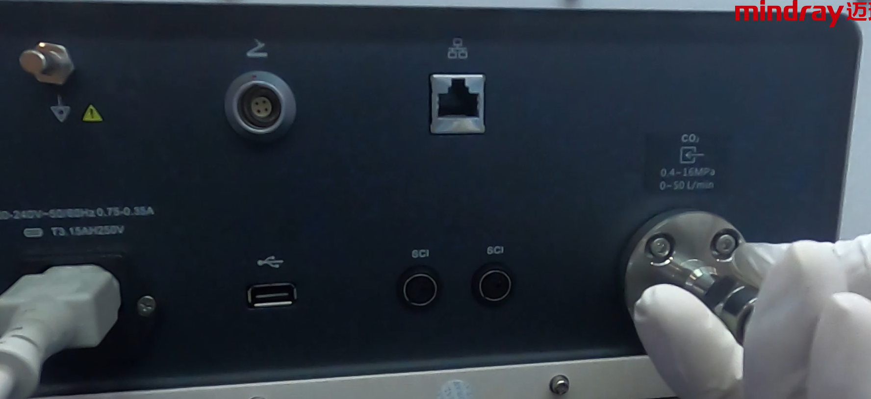
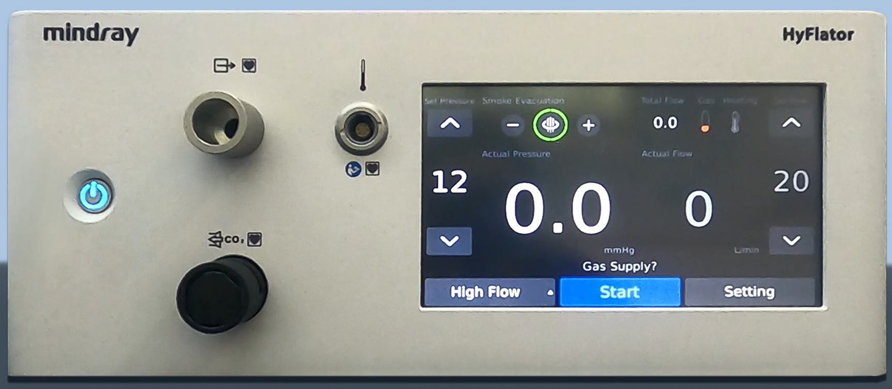
Test Items
Function Test: Inflation Function Test
Connect the gas source and power supply and ensure that the gas source pressure is ≥ 0.4 MPa.
Start the insufflator and enter the standby state.
Connect the insufflator tube and start inflation.
If the insufflator works properly with no abnormal error prompt, the inflation function test is passed.
Connect to gas source
Connect with insufflator tube

Slide 25
Version | Author | Date | Description
1.0 | Marcos Magalhaes | 05/17/2025 | First Version
Calibration and Test after Software Upgrade

